Slide 1
13. Public Opinion
& Mass Media
Breakout Sessions
POLS 1101
12:40pm-1:30pm Park Hall 145
& 1:50pm-2:40pm Leconte Hall 135
SIYUAN (Siri) ZHAO
Siri.Zhao@uga.edu

Slide 2
Public Opinion and Democracy
Majoritarianism: A majority of the people holds clear, consistent opinions on government policy. The government should act as it’s expected.
Pluralism: The public as a whole seldom demonstrates clear, consistent opinion. The government should allow free expression from “minority publics”.
  Opinion polls tend to support that the public is uniformed. -> Is it accurate?
    How the sample is selected (random sample is better)
    The size of the sample (larger sample is better)
    The amount of variation in the population (greater / less variation?)
  E.g. If we wish to know the ideology distribution of the public through observing what they post on X (Twitter), what are the advantages and disadvantages?
  Shape of the opinion distribution, and its political implications
    Normal distribution -> moderate government policy
    Skewed distribution -> a high level of consensus, but can overlook minorities
    -> Does the political process sometimes depend more on how many people strongly oppose an issue than on how many people strongly support it?
    Bimodal distribution -> political conflict
Notes:
Scope and aim of your research

Slide 3
Stability of Public Opinion Matters!
A stable distribution: opinions show little change over time.
However, even the most enduring ideological labels were not always this way.
  Abortion
    In the early years, there was much more ambiguity: both parties had factions for and against abortion, and public opinion was not strongly split along party lines. (Biden was against the abortion right when he was newly elected as a senator!)
    After the 1973 Roe v. Wade decision legalized abortion nationwide, conservative religious movements and Republican strategists turned abortion into a central cultural and electoral issue, while Democrats increasingly aligned with abortion-rights advocates.
    Politicians choose sides, and voters follow. Now it’s one of the most partisan-related issues in U.S.
  Same-sex marriage
    It gained more public approval in the past years (driven in part by President Trump’s general acceptance of it, so that Republican Congress members could vote for their own view).
    After Dobbs v. Jackson Women’s Health Organization, things may change…
  Public opinion can evolve under the impact of politics; can even totally turn to the opposite position! (“changing definitions of a problem”)

Slide 4
Stable Ideology-related Public Opinion
A general conclusion: People’s ideological and partisan orientations tend to represent fairly stable distributions. – Risk of overlooking subgroups
  That’s why we need random sampling, large sample size, and more heterogeneity.
Fact: we hear about polarization every day, but there are still many people self recognized as ”moderate”.
Be cautious when labeling people – even for yourself!
  Social identity confirmation: You can tend to be what you claim to be!
Does “value-free” or moderate position mean political apathy?
Would you think political apathy something good (or bad)?
Can the moderate majority, though seemingly ironic, be under-represented (because they don’t like to reveal their preferences)? Especially, under the discursive power of elites and the ideology of “paying more attention to marginalized groups”?

Slide 5
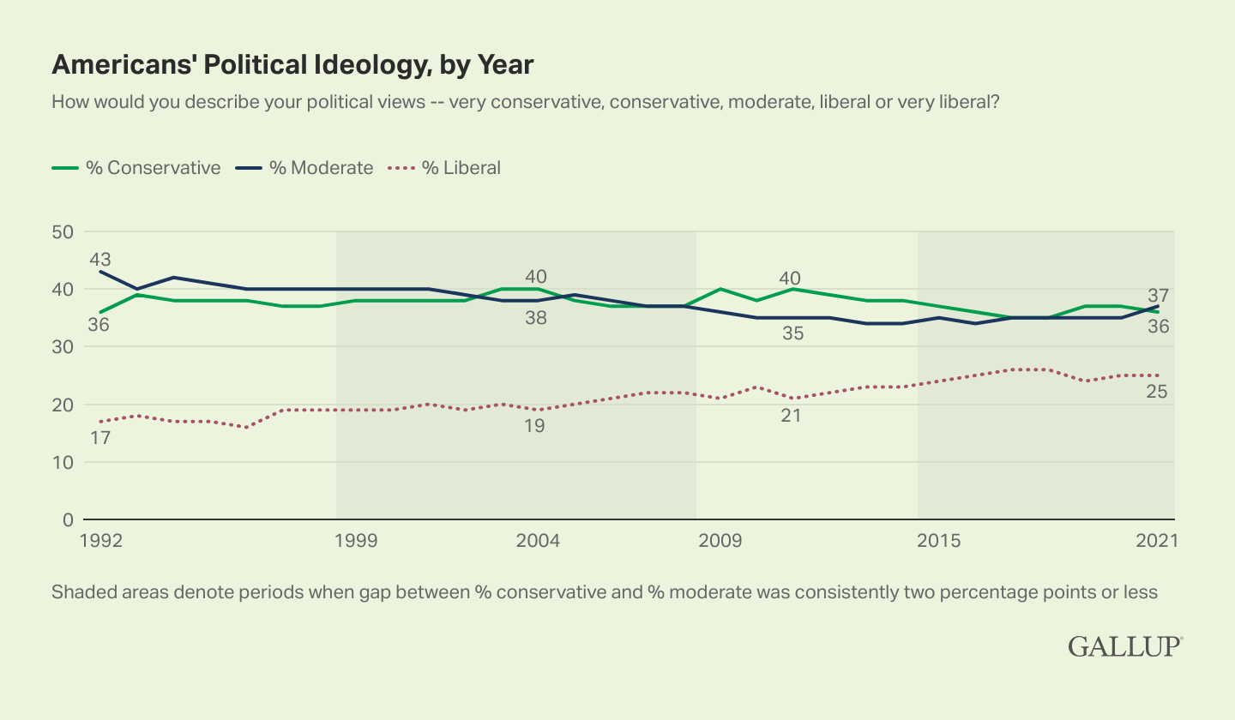
Which of the three ideological labels shows the greatest change in group proportion?
Has the proportion of moderates increased or decreased over time?
Whenever there are major political events (such as economic crises, elections, or social movements), do the proportions of these labels show short-term fluctuations?
Which forces might be driving this “relabeling” process?
Source: https://news.gallup.com/poll/388988/political-ideology-steady-conservatives-moderates-tie.aspx?utm_source=chatgpt.com

Slide 6
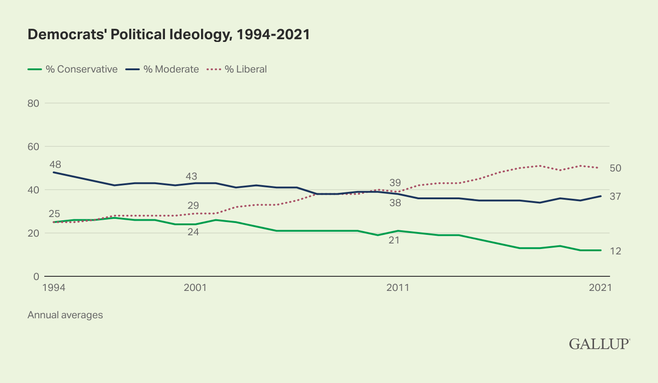
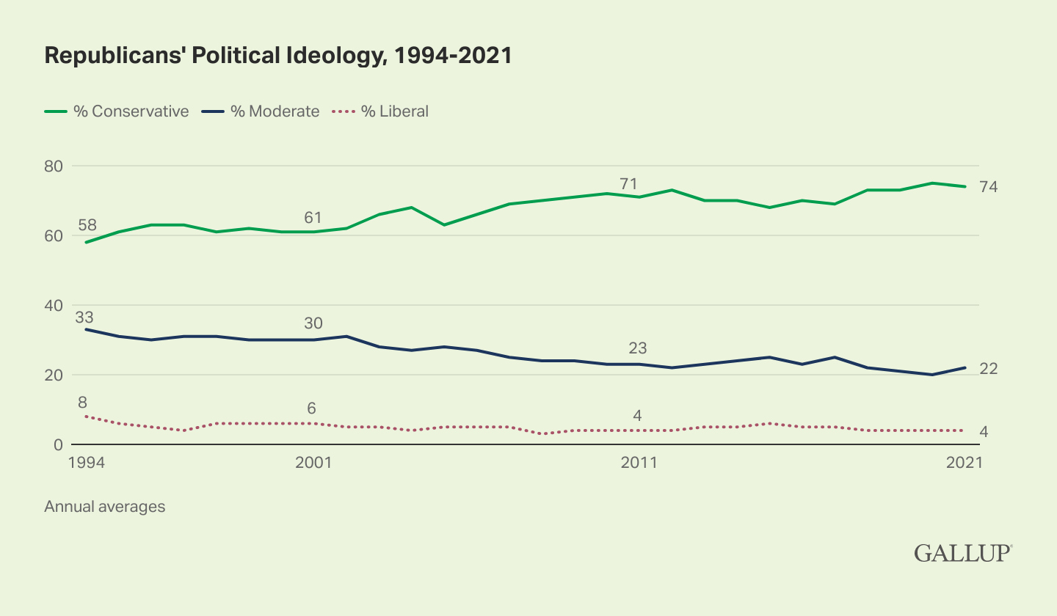
What do you find?
Are there any fun and/or important facts?
Source: https://news.gallup.com/poll/388988/political-ideology-steady-conservatives-moderates-tie.aspx?utm_source=chatgpt.com

Slide 7
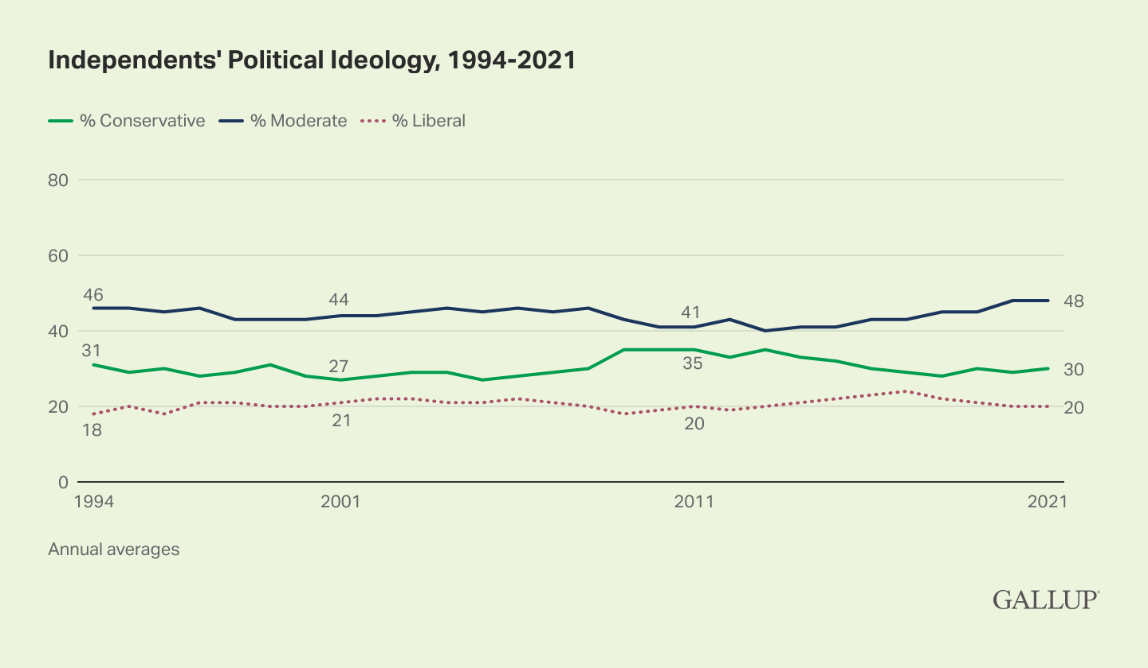
What inspirations can we get from this trend (or almost “no clear trend”)?
Source: https://news.gallup.com/poll/388988/political-ideology-steady-conservatives-moderates-tie.aspx?utm_source=chatgpt.com

Slide 8
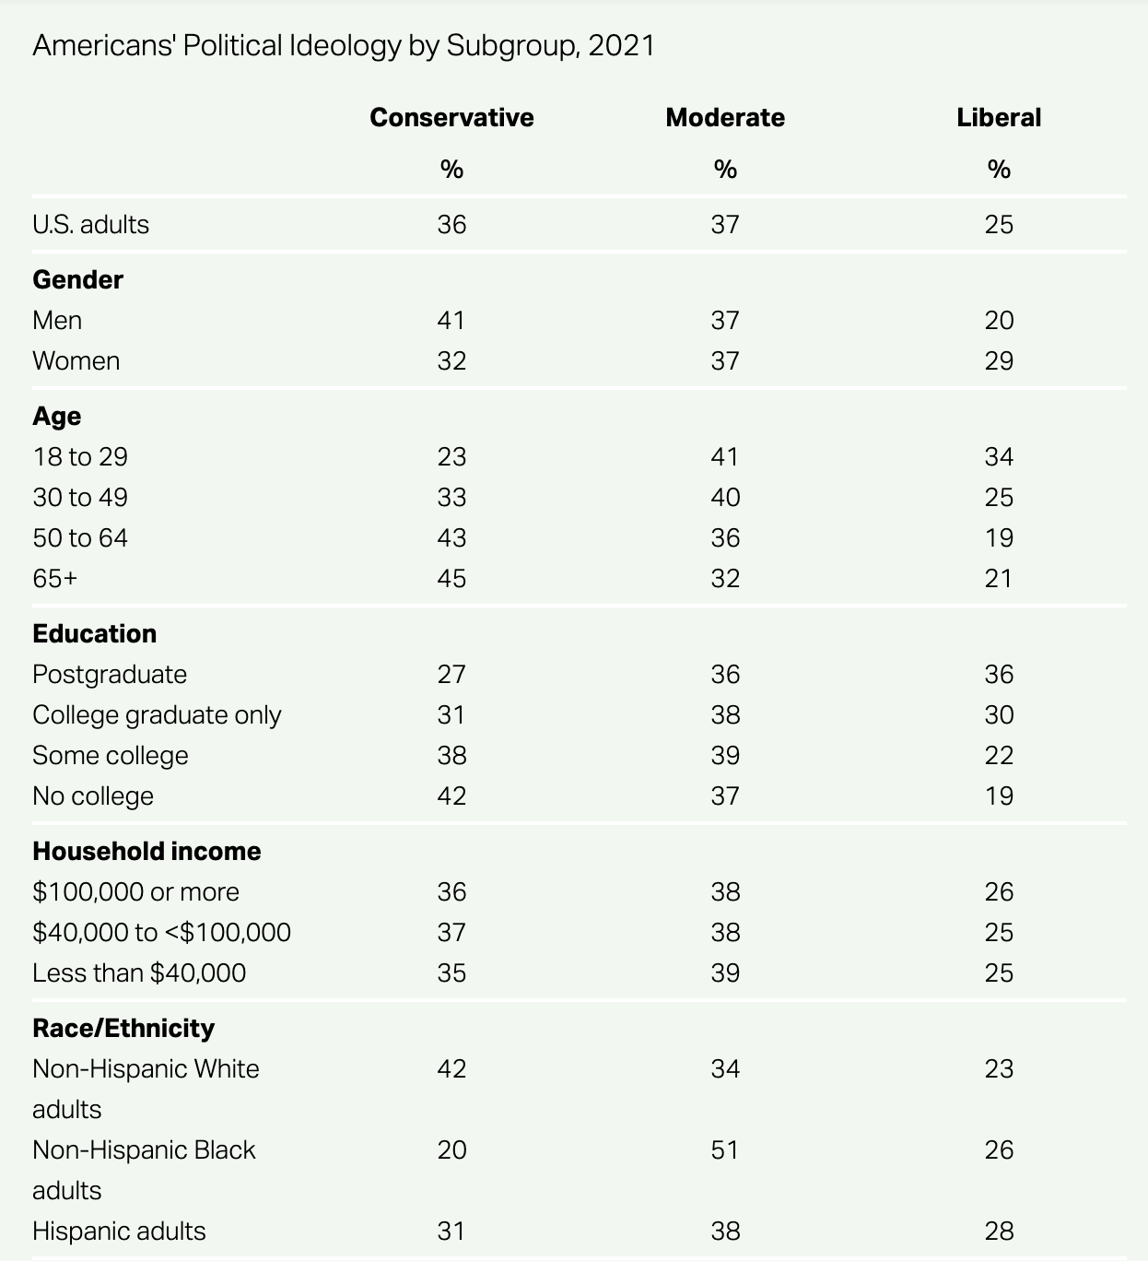
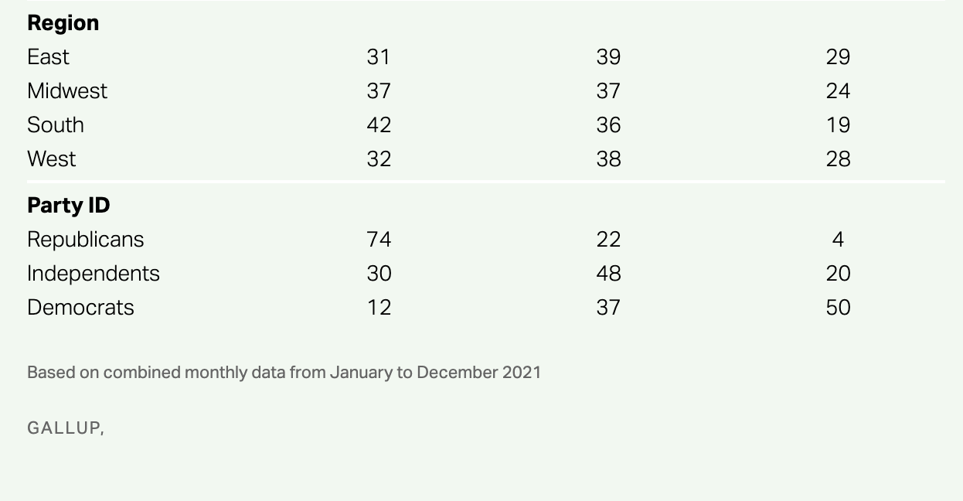
What do you find?
Are there any fun and/or important facts?
Source: https://news.gallup.com/poll/388988/political-ideology-steady-conservatives-moderates-tie.aspx?utm_source=chatgpt.com

Slide 9
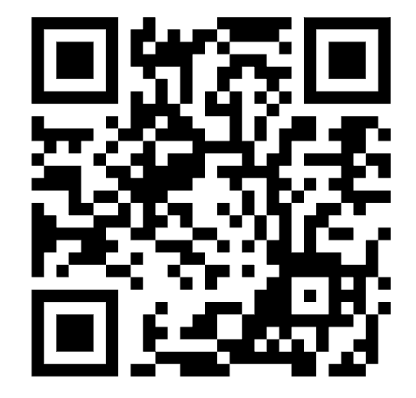
How People Form Their Opinions?
Political socialization
  Family (transmission model)
  School (social order -> civic education -> more critical thinking)
  Community & peers (homogeneity; “information bubble” as the result of self selection)
  Continuing socialization (workplaces; mass medias)
Predictors of public opinion
  Education, income, region, ethnicity, race, religion, gender… (“SES”)
  Political knowledge
    https://www.pewresearch.org/politics/quiz/what-do-you-know-about-the-u-s-government/
  Cost-benefit analysis and cues, based on self-interest
    “National interest” – “sociotropic responses”: how the country as a whole is doing can affect political preferences more strongly than one’s own personal circumstance.
    Do you have such experiences? (maybe, to some degree, related to “patriotism”?)
  Political leadership (by issue framing)

Slide 10
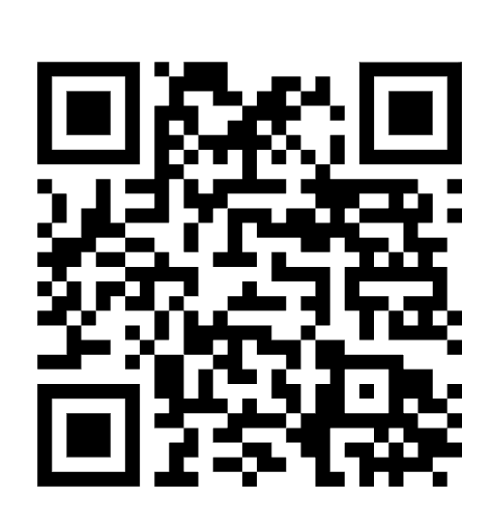
Mass Media
Let’s start with a 1-minute survey on media use!
Print (Newspapers)
Broadcast (Radio & Television)
  “Higher-dimensional” information: compared with print media, they are more likely to influence public opinion. (by affecting attentive policy elites first; under the two-step flow of communication, elites inform their followers to pressure the government)
Internet
  Most convenient, but sometimes less reliable (too many sources of information!)
In “Big data” era, should print and broadcast media still exist? Why or why not?

Slide 11
Private Ownership of the Media
What could happen if media is controlled by the government?
The consequences of private ownership
  Market-driven entertaining news – newsworthiness lies in audience appeal.
    E.g. infotainment / soft news: a mix of information and diversion oriented to personalities or celebrities; not linked to the day’s events, and usually unrelated to public affairs / policy.
  Concentration (Natural monopoly?)
Government regulation of the private media (See textbook)
  Should there be any kind of media regulation (e.g. in the name of protecting public morality or national security)? Why or why not?
  How has the rise of AI-generated content changed the meaning or feasibility of media regulation?

Slide 12
Functions of the Mass Media
Reporting the news: How the media cover political affairs
  President: through the Office of the Press Secretary (e.g. news release); Truth Social?
  Congress: press releases, congressional reports, members’ social networking accounts
Interpreting and presenting: What they choose to become news (“Gate-keeper”)
  Horse race journalism in elections – because individuals have attractive personalities!
  Media events that the mass media are compelled to cover
  Television hypothesis: Television is to blame for the low level of citizens’ political knowledge (fragmental information, personal view, under regulation of FCC – can discourage respect for different opinions and lead to political distrust) -> Is it fair?
Claims of ideological bias among the mass media may be overblown.
  Journalists are liberal, but there are no gatekeeping bias and minimal framing bias.
    Journalists were just as likely to respond to very conservative candidates as very progressive candidates. They weren’t more interested in covering a candidate of their own ideology.
    Conservative newspapers are not overt Trump cheerleaders, and liberal outlets are not overly negative.

Slide 13
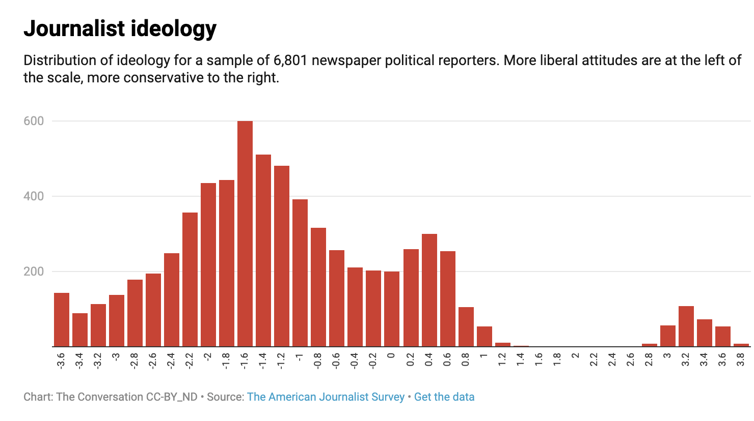
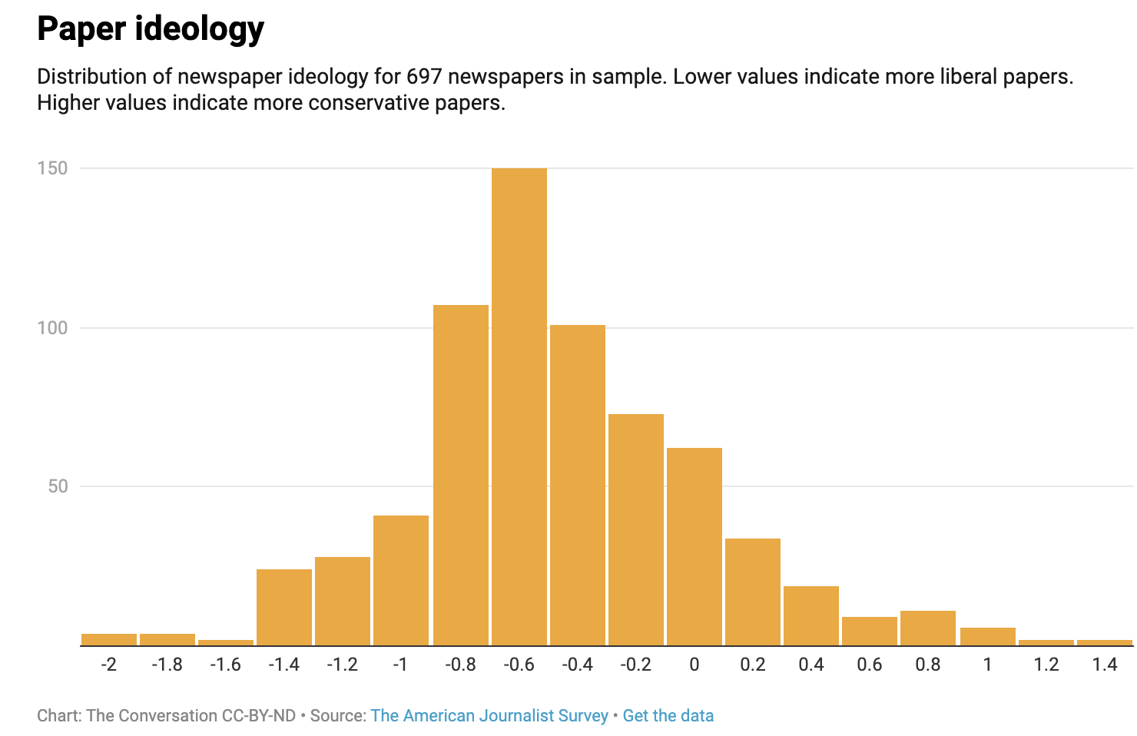
What does this pattern mean,
  when we wish to connect “attitude” with “behavior” in an unquestionable way?
  when politicians claim that there are bias in the media to undermine negative coverage or avoid blame?

Slide 14
Functions of the Mass Media (cont`d)
Setting the political agenda: Who follows the news
  Forcing the government to confront issues identified as needing attention
  Can also keep the agenda issues that perhaps should attract fewer public resources
  Can social media users set the political agenda in the same way traditional media do? Why or why not?
Socializing the citizenry: What they remember and learn
  A channel for young people to be “socialized” (talked before)
  Reinforce the hegemony of existing culture and order
  Contradictory roles: to promote popular support for government, or to erode public confidence
  Is political socialization through media primarily a cognitive process (learning information) or an affective one (developing attachments and identities)?

Slide 15
Evaluating the Mass Media
Bias do exist (to some extent), but it doesn’t matter sometimes.
  Value-freedom is merely ideal type! And people can have “self-selection”.
Contributions to democracy
  Watchdog journalism: Journalism that scrutinizes public and business institutions and publicizes perceived misconduct.
  Use their polling expertise: to generate more accurate knowledge of public opinion and to report that knowledge to public officials as well as to the public - so the public opinion influences policy, fit to the majoritarian model of democracy.
Effects on freedom, order, and equality
  Advancing equality (even at the cost of some personal freedom)
  Resisting government attempts to exchange freedom of the press for order
    Democracies sometimes sacrifice order when they preserve freedom
  Should journalists engage in a way of activism when reporting on moral issues?
  Under potential political pressure, should journalist still keep professional ethics?
Notes:
Self-selection 导致另一个问题：polarization?
其他对民主的贡献：深度调查研究、澄清事实的能力

Slide 16
Next week…
Read materials on Participation & Voting before class, and that will be helpful to participate in peer discussions.
Feel free to email me if you have any questions!
ENJOY YOUR WEEKEND!

